Slide 1
Social Media Marketing For Lodges

Slide 2

The Pillars Of Social Media Marketing
  Owned Media
  Earned Media
  Shared Media
  Paid Media

Slide 3
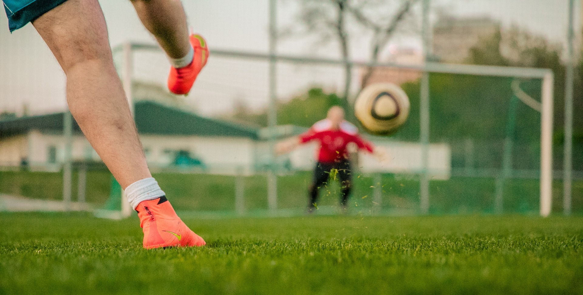
Online Communication Strategy
  Social Media Is NOT A Strategy
  Ogranizational Objectives
  What Is Your Goal?

Slide 4
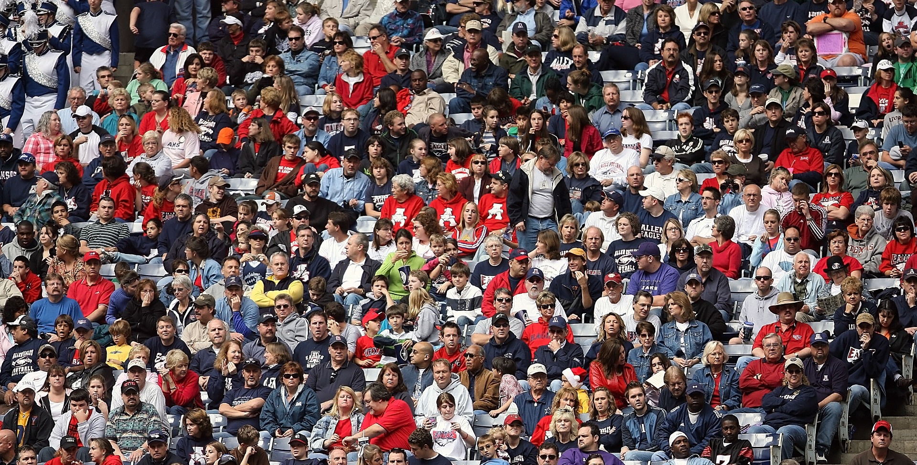
Target Audience
  Who Do You Need To Reach?
    Who Are They?
    What Do They Need?
    How Can You Reach Them?

Slide 5
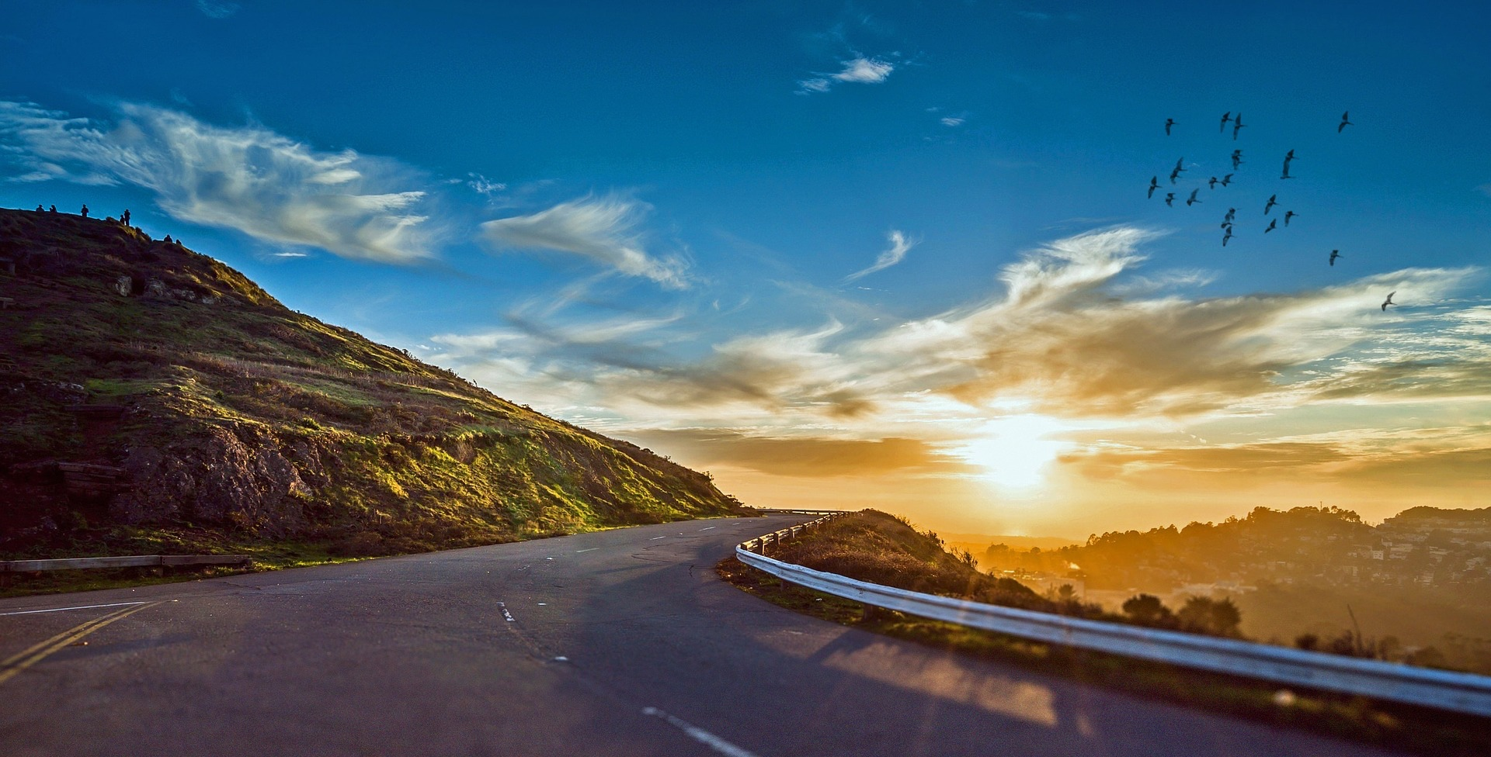
Customer Journey
  Awareness
  Consideration
  Purchase
  Retention
  Advocacy

Slide 6

Social Media Channels
  How People Use Social Media
    Share
    Discover
    Follow
    Inspire
    Entertain
    Develop

Slide 7
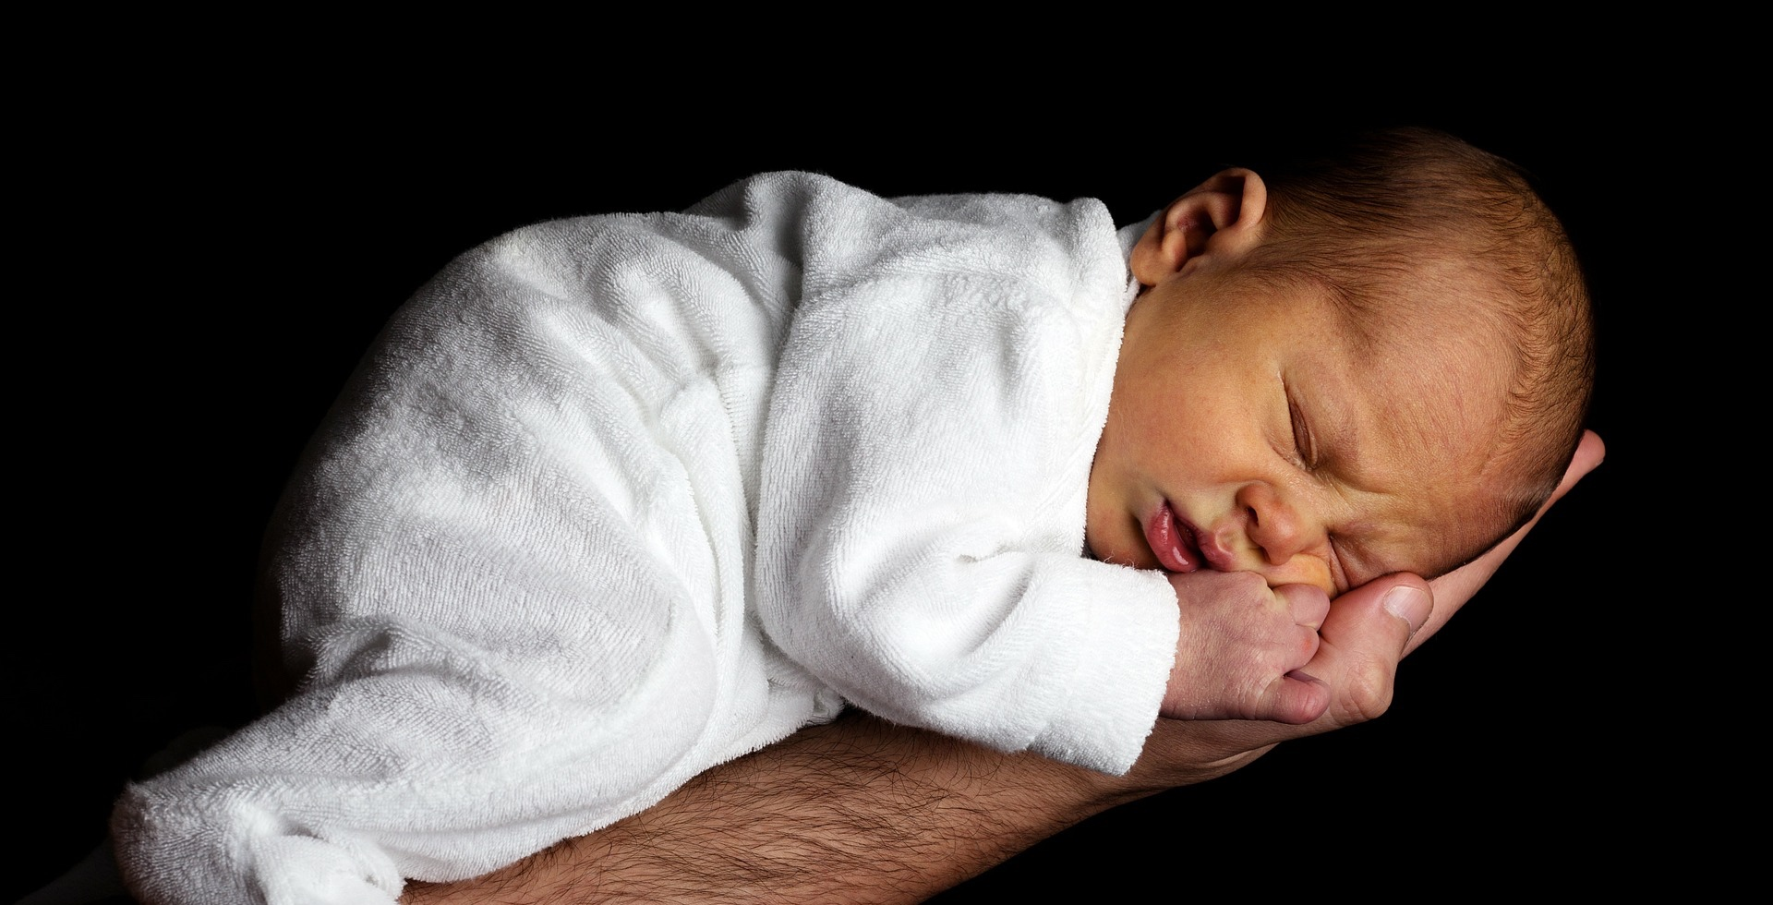
Facebook
  How People Use Facebook
    Family & Friends
    News
    Connect/Organize
    Amuse
    Communicate
    Advertise

Slide 8
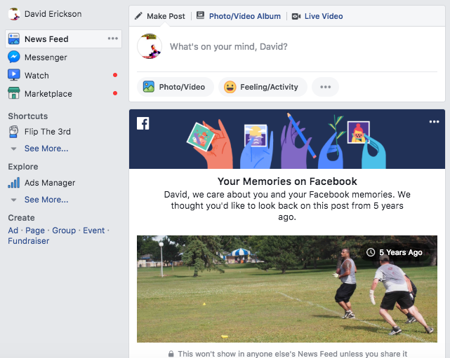
Facebook: User Behavior - Newsfeed
  How People Use Facebook
    Friend Or Follow
    Newsfeed Algorithm

Slide 9
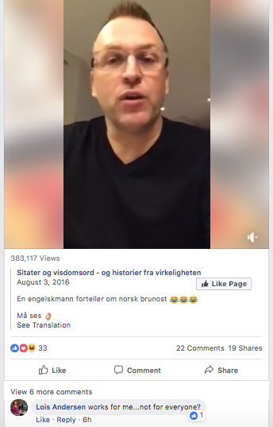
Facebook: User Behavior - Engagement
  How People Use Facebook
    Enagagement
      Likes
      Views
      Reactions
      Shares
      Comments

Slide 10
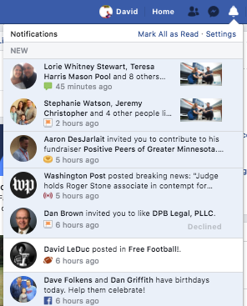
Facebook: User Behavior - Engagement
  How People Use Facebook
    Notifications

Slide 11
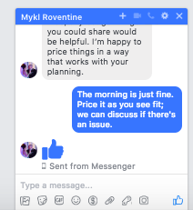
Facebook: User Behavior - Messaging
  How People Use Facebook
    Messaging

Slide 12
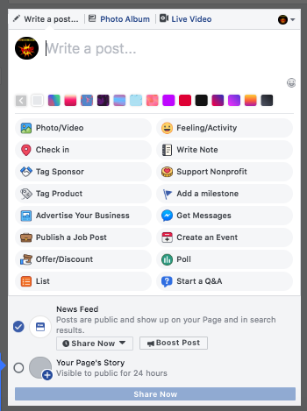
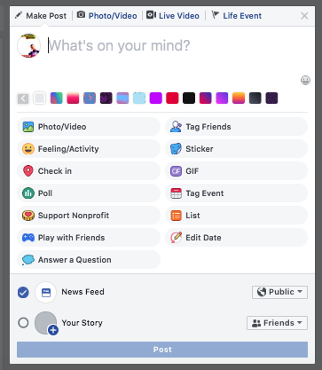
Facebook: Content Types
    Status
    Photos
    Videos
    Notes
    Check Ins
    Events
    Lists
    Polls
    Q&A

Slide 13
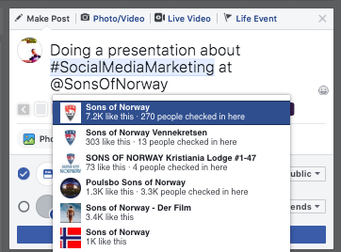
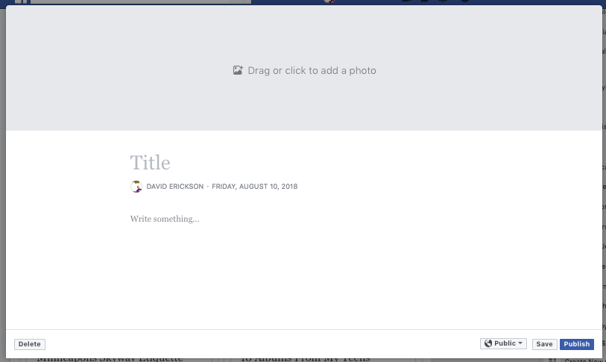
Facebook: Posting Status/Notes
  Tagging
  #Hashtags
  Location Tagging
  Emotion Tagging
  Blogging

Slide 14
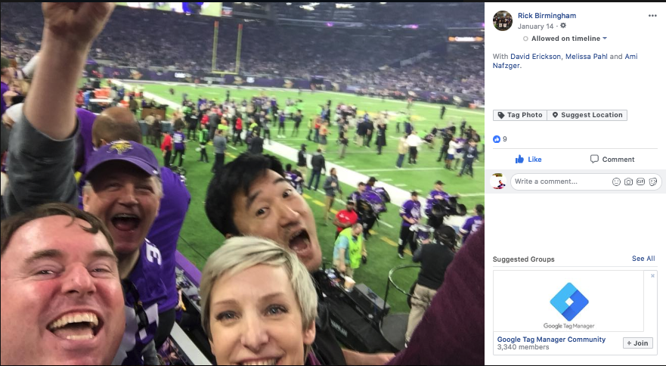
Facebook: Posting Photos
    Subject Tagging

Slide 15
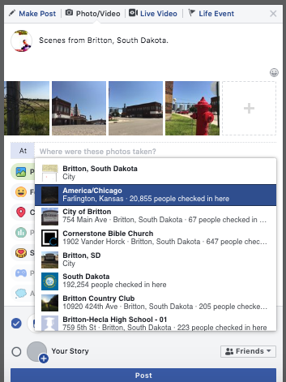
Facebook: Posting Photos
    Location Tagging

Slide 16
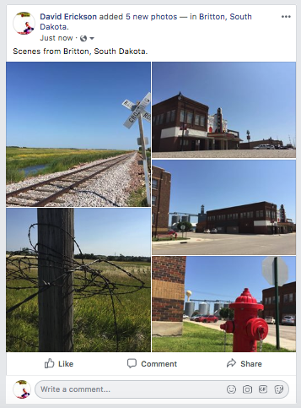
Facebook: Posting Photos
    Galleries & Slideshows
      Tell A Story

Slide 17
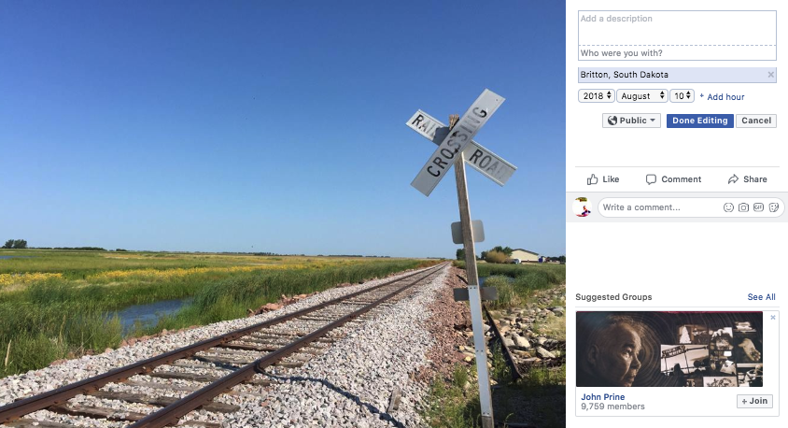
Facebook: Posting Photos
  Optimize
    Description
    Tag People
    Tag Locations
    Date & Time
    Encourage Engagement

Slide 18
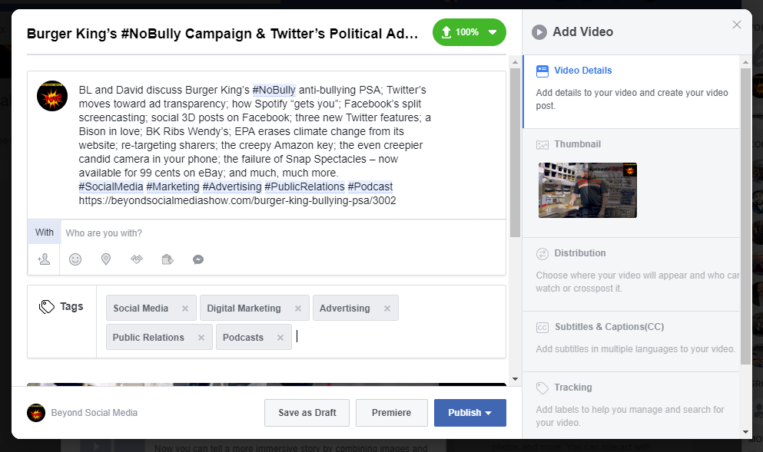
Facebook: Posting Video
  Optimize
    Title
    Description
    #Hashtags
    Tags
    Tag People
    Tag Location
    Tag Emotion
    Thumbnail
    URL

Slide 19
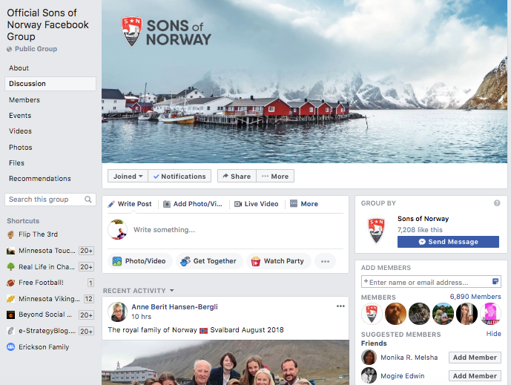
Facebook: Group Participation
  Many To Many
  Engagement
  Share Documents
  Organize Events
  Community Management

Slide 20
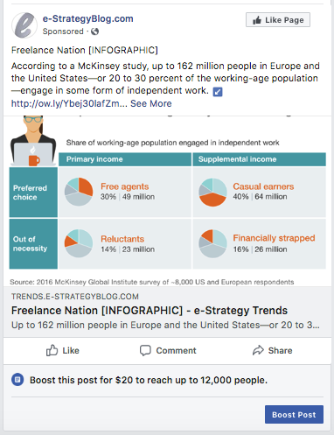
Facebook: Advertising
  Boost Posts
  Targeting Options

Slide 21
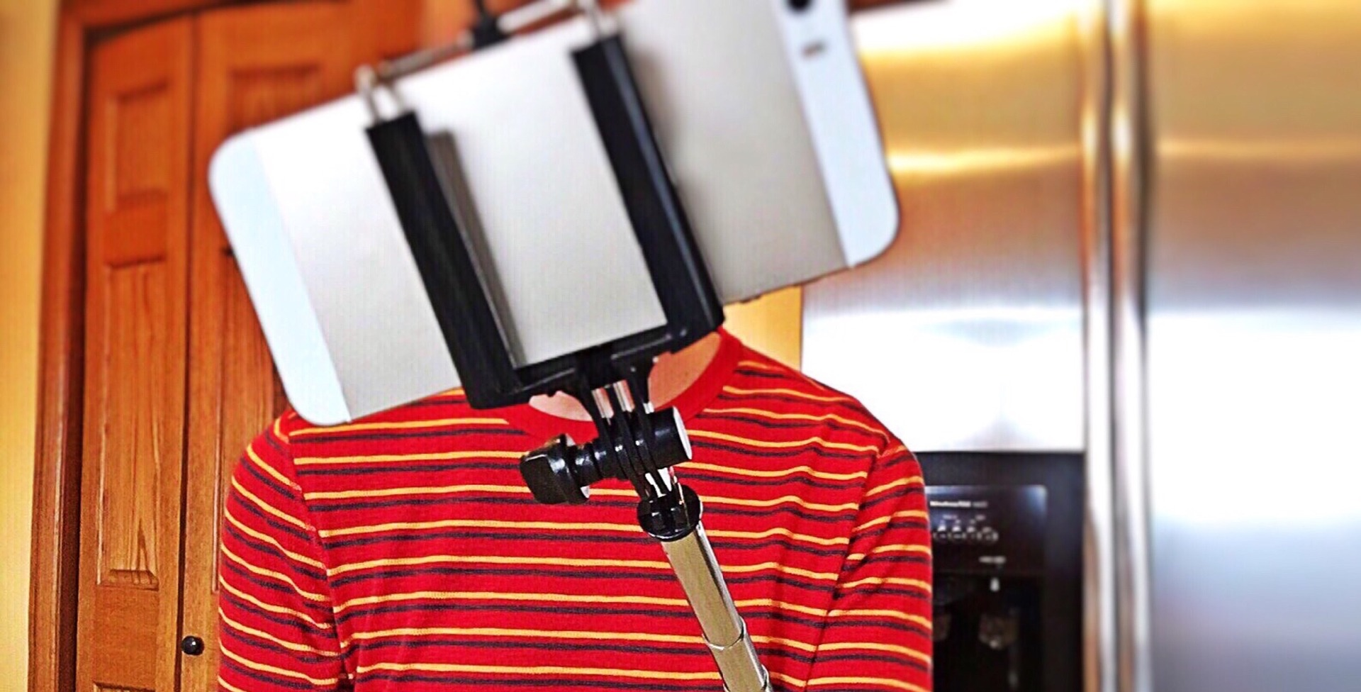
Instagram
  How People Use Instagram
    Family & Friends
    Curated Life
    Specific Theme

Slide 22
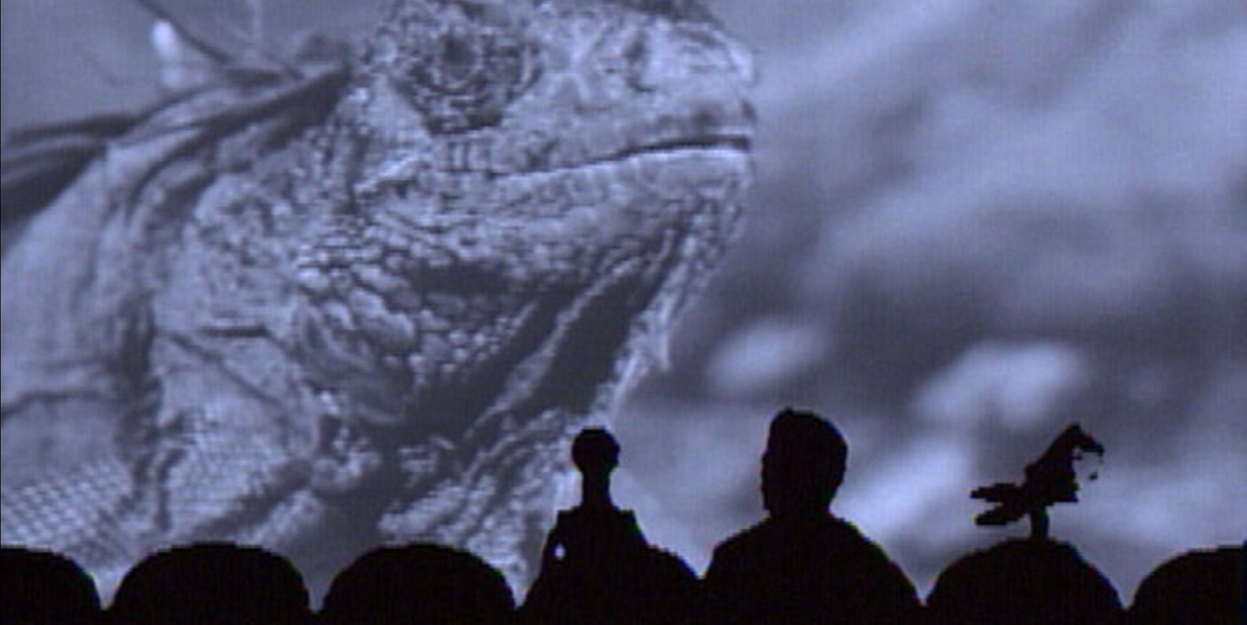
Twitter
  How People Use Twitter
    Real-Time
    Current Events

Slide 23
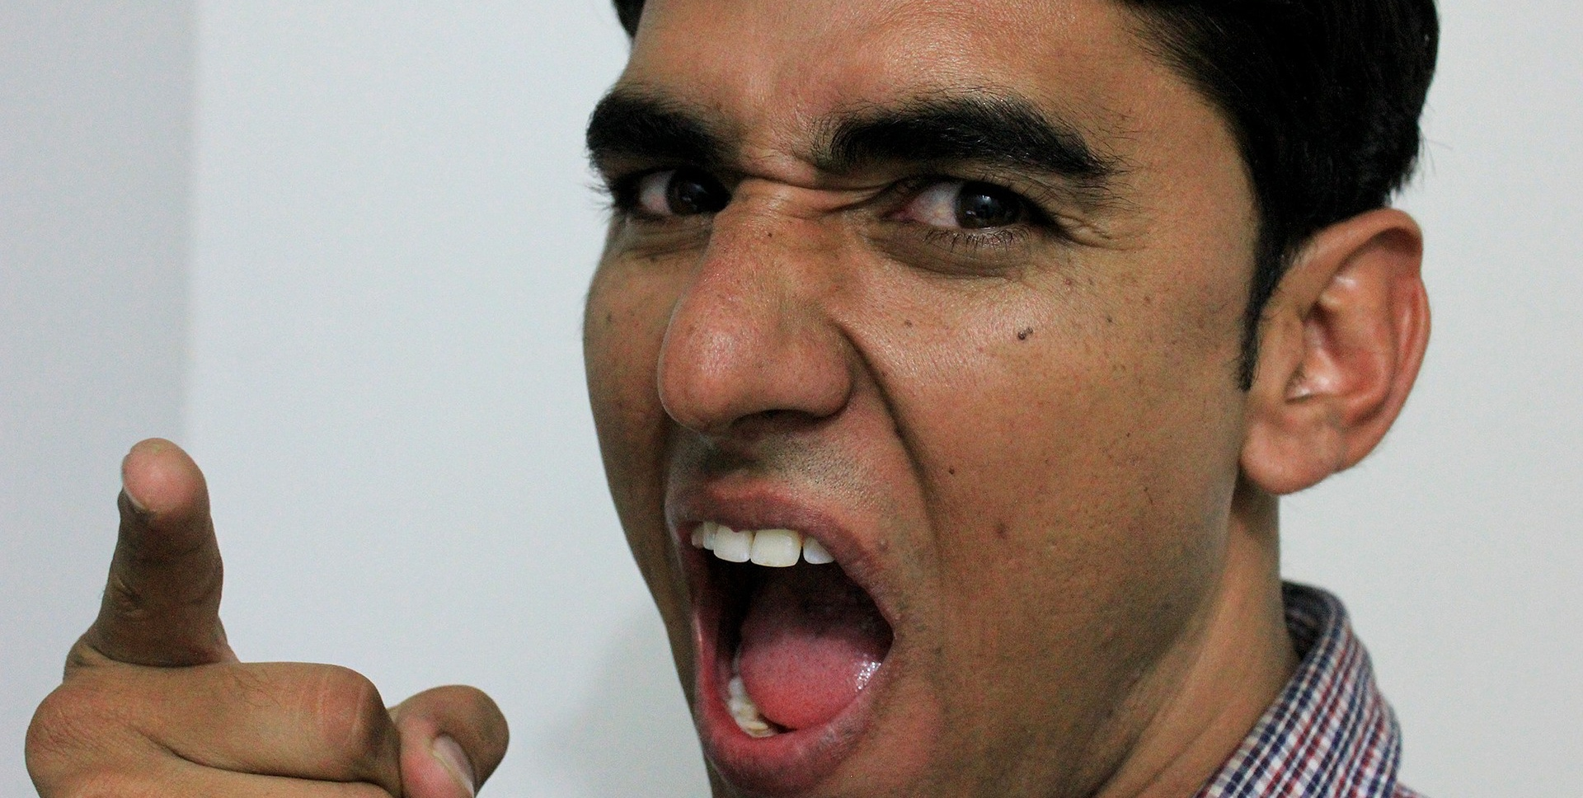
Twitter
  How People Use Twitter
    Debate/Yelling

Slide 24
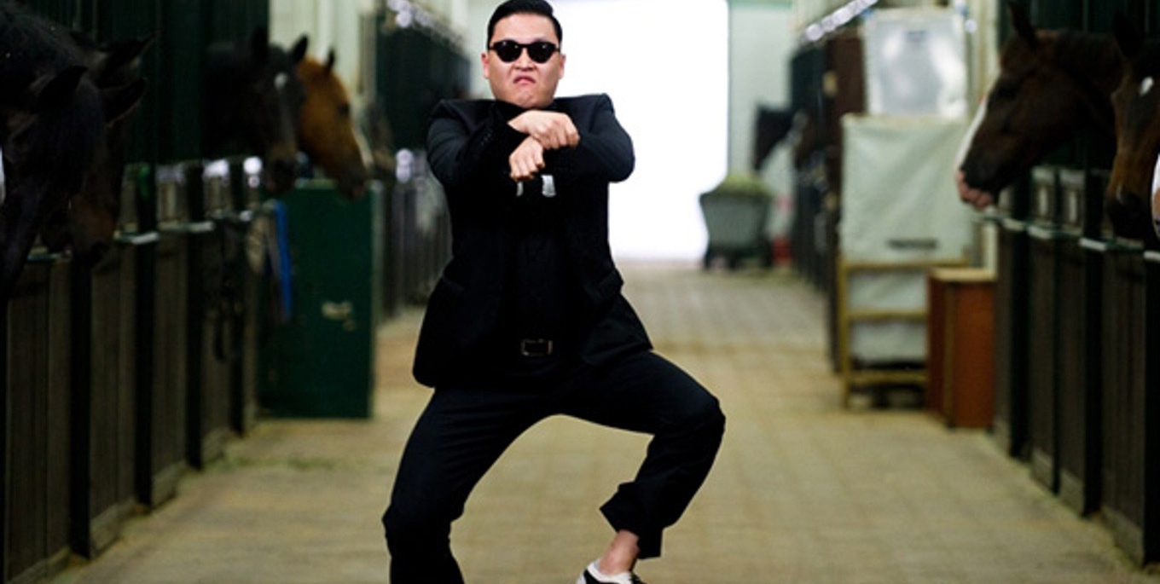
YouTube
  How People Use YouTube
    Music
    Trailers
    Viral Videos
    How To
    Educational
    Products
    Commercials

Slide 25

LinkedIn
  How People Use LinkedIn
    Resume/Job Seeking
    Networking
    News
    Education

Slide 26
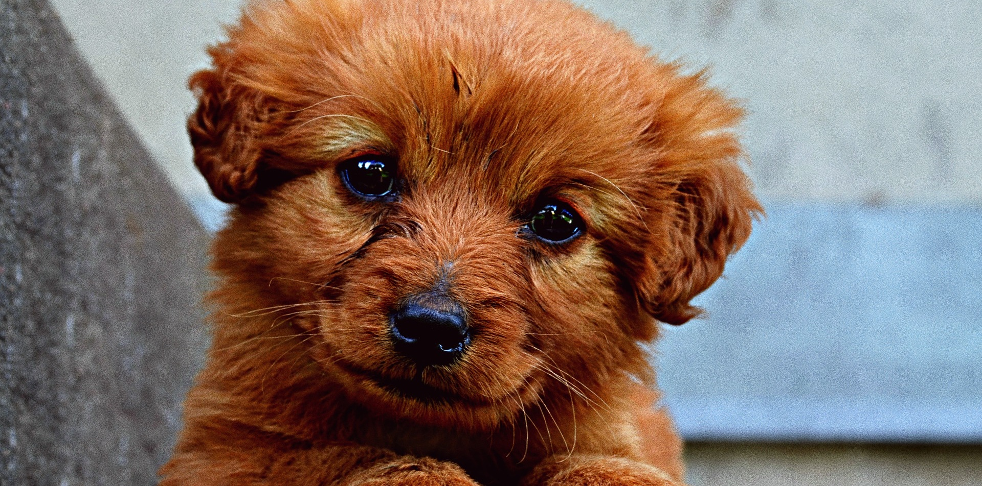
Questions

Slide 27
Thank You
Notes:
Integrated marketing

