Slide 1
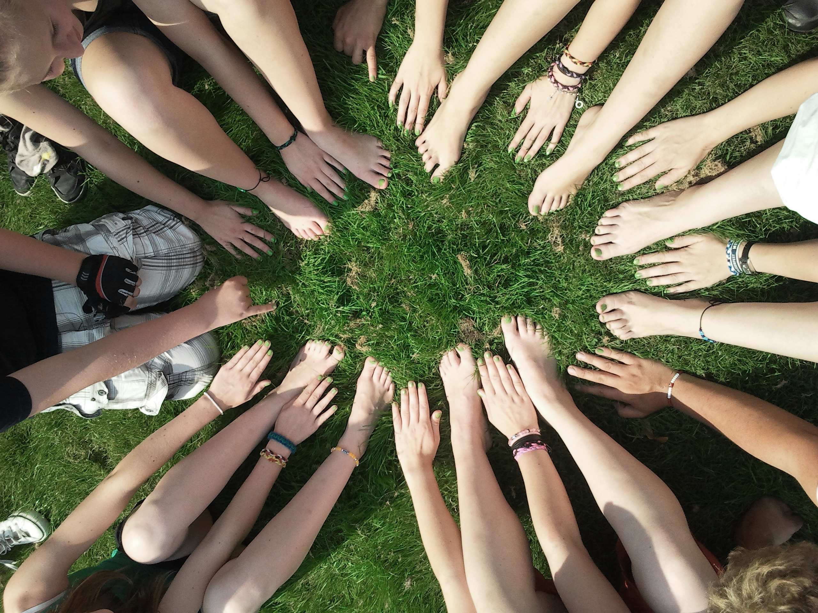
Gather4Good
Planning mission-based service events in your lodge
Kaitlin Groeneweg
Member Engagement Advisor
Notes:
Catholic United Financial is a Fraternal Benefit Society just like SoN. 140 years old this year, and our common bond is Catholicism.

Slide 2
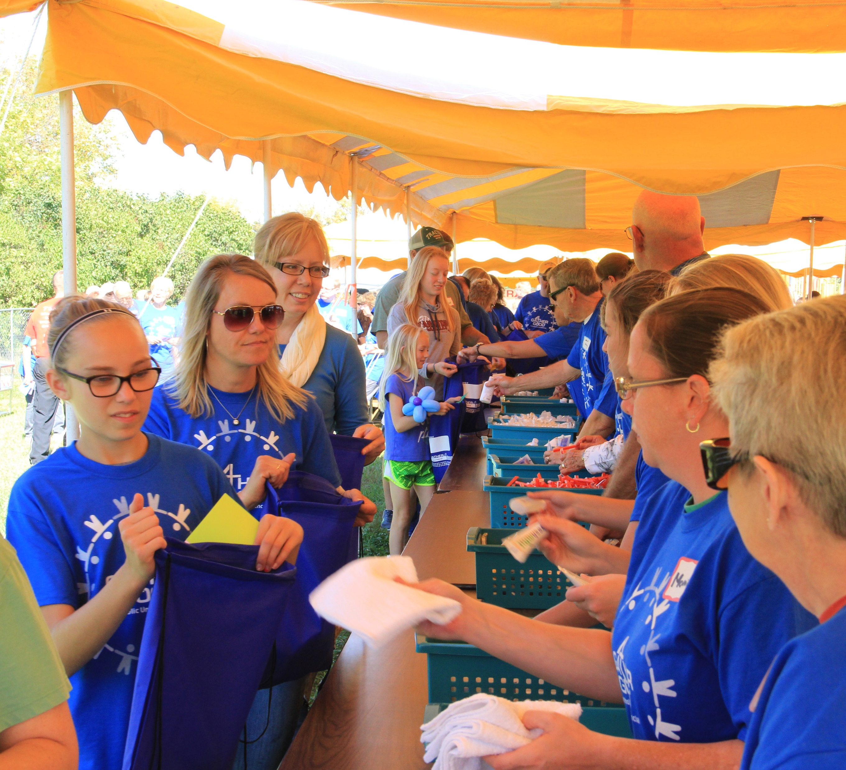
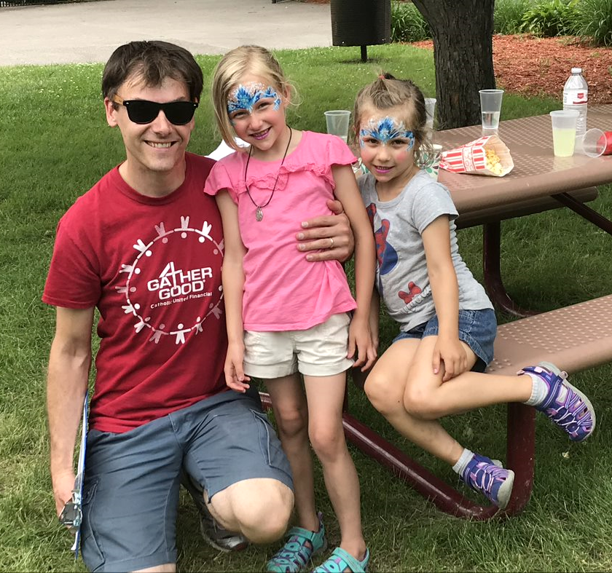
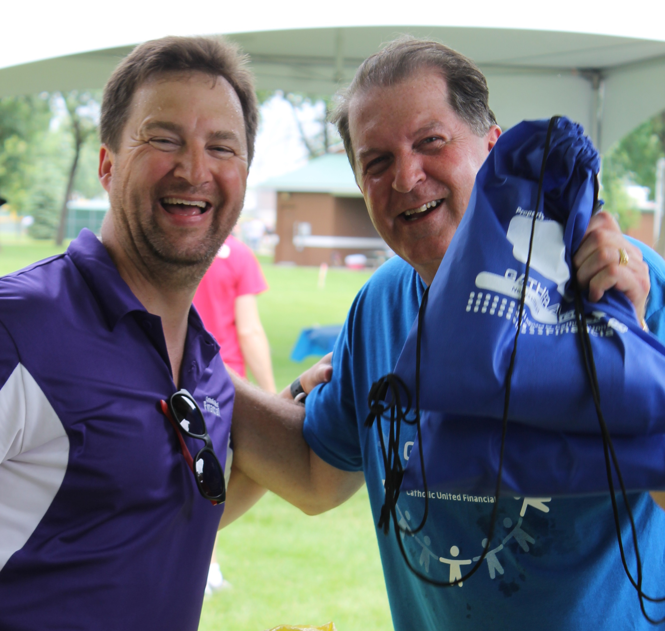
Service Event
Family Friendly
Local Community
Notes:
Special program sponsored by Catholic United. It started in 2010. Since then, we have assembled over 33,000 kits at 17 events all over the 5-state area in which we serve.
We host the events in different cities within the 5-state area of Minnesota, North Dakota, South Dakota, Wisconsin, and Iowa. We do this by partnering with local Catholic United Sales Reps and our local Councils (lodges) to hold the events at local Catholic churches, schools, or parks. On average, we pack 2,000 kits per event, and donate them to local homeless shelters, domestic violence shelters, food shelves, and other service agencies.
We rely on local volunteers to make each of these events a success. Today, we are doing a mini version of Gather4Good together.

Slide 3
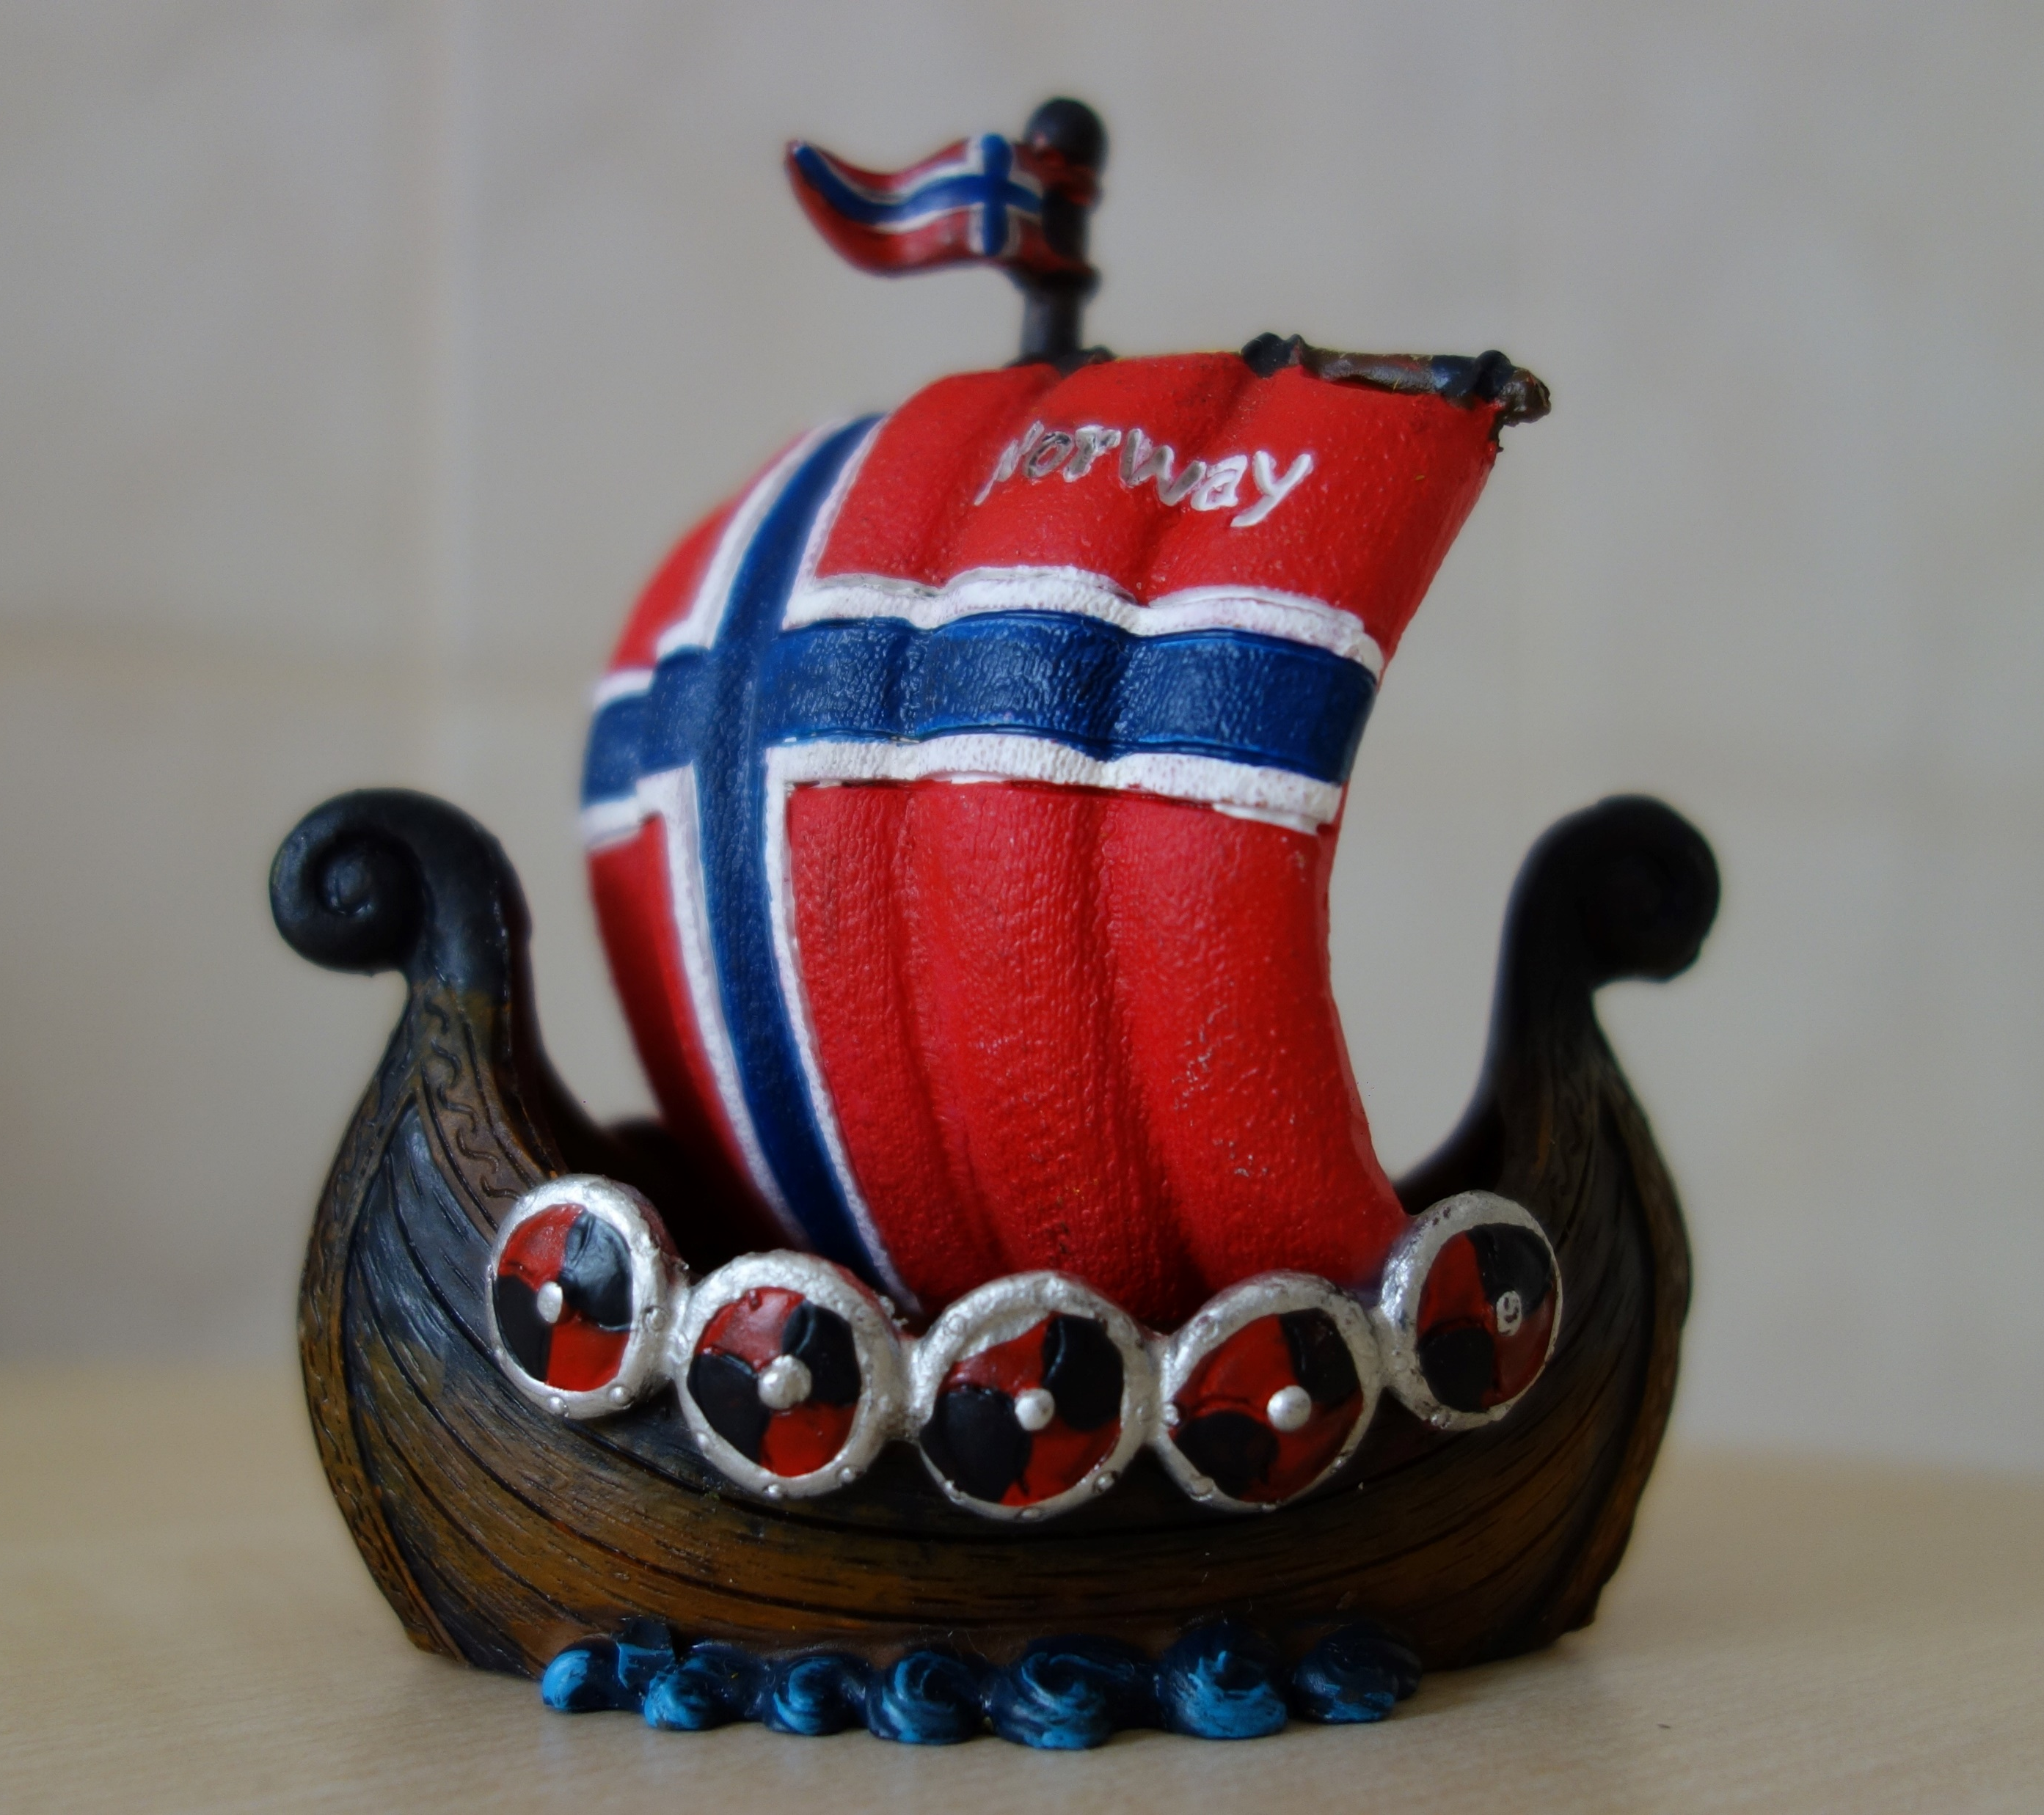
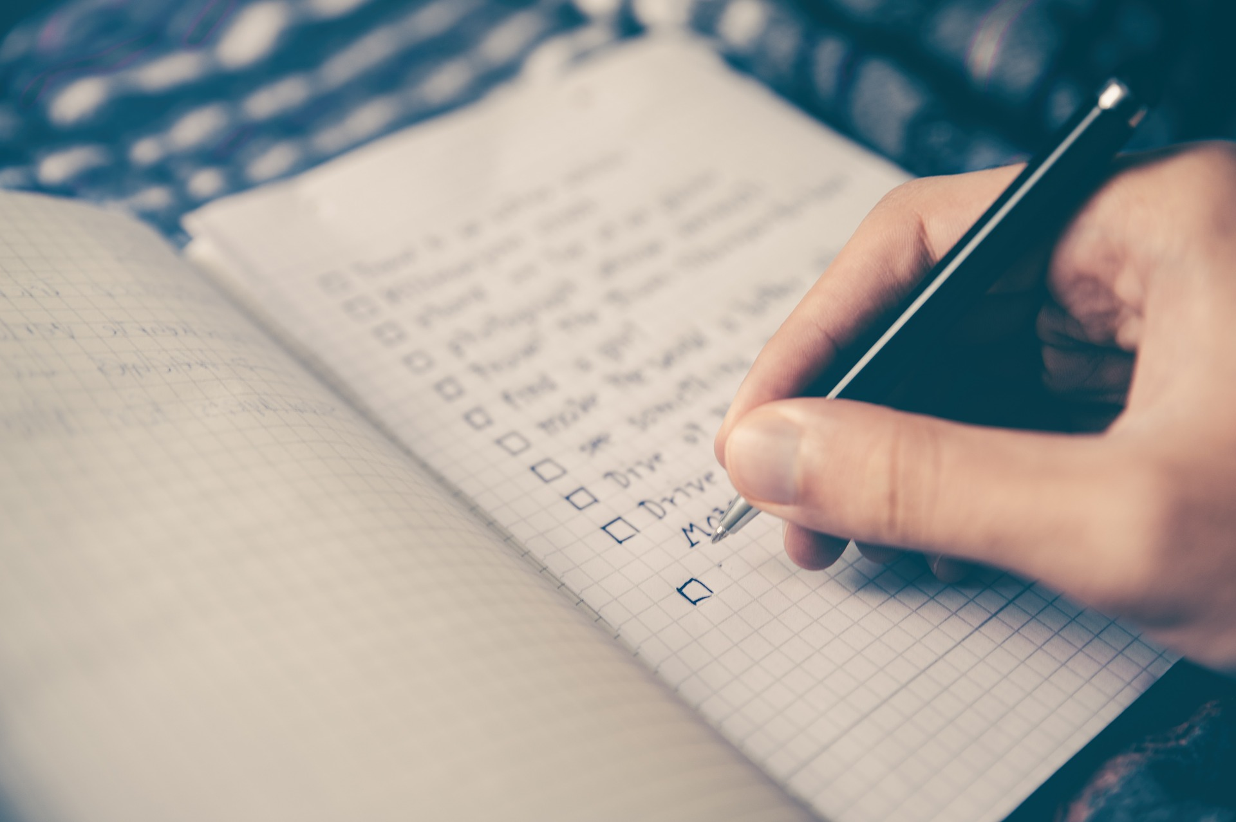
Service at your Lodge
Mission in Action
1
2
3
4
Mission
Goals
Evaluation
Tactics
Impact
Notes:
Gather4Good is a large service project organized and sponsored by Catholic United Financial, but how can you as local groups of volunteers replicate this model in your communities? We have 4 basic steps for you to consider.
Identify your mission
Set goals
The tactics involved in planning a successful event
The evaluation and follow-through

Slide 4
Our Mission
Mission
Promote and to preserve the heritage and culture of Norway
Celebrate our relationship with other Nordic Countries
Provide quality insurance and financial products to our members.
Notes:
You see this mission come to life through many of your member benefits and the way in which they run their business. At Catholic United, we encourage each of our Councils to adopt their own mission inspired by our company mission. This is to act as their starting point as they plan the types of events that they will host throughout the year.
For each of you as volunteers -
Why do you do what you do?
What is the big picture?
Do you have a desired outcome?

Slide 5
Using Your Mission
Lodge Contacts
Who are the contacts in your lodge?
What groups could use your support?
What are their needs?
Community Contacts
Who knows community needs?
How can you help beyond the lodge?
Can you engage other communities?
Mission-based Events
What aligns with your mission? Can you reach goals for the year?
Meeting the needs of your contacts?

Slide 6
Specific
SMART Goals
Measurable
Who, when, what, were, and why?
Are other resources needed?
Achievable
How much or how many?
How will we know when it is accomplished?
Relevant
How can we accomplish this goal?
Are there constraints on factors like time or budget?
Time-based
Does this align with our mission?
Is now the right time?
Is this a short or long-term goal?
What is the timeline for completion?
Notes:
Specific: Your goal should be clear and specific, otherwise you won't be able to focus your efforts or feel truly motivated to achieve it.
Measurable: It's important to have measurable goals, so that you can track your progress and stay motivated. Assessing progress helps you to stay focused, meet your deadlines, and feel the excitement of getting closer to achieving your goal.
Achievable: Your goal also needs to be realistic and attainable to be successful. In other words, it should stretch your abilities but still remain possible. When you set an achievable goal, you may be able to identify previously overlooked opportunities or resources that can bring you closer to it.
Relevant: This step is about ensuring that your goal aligns with your mission, and that it also aligns with other relevant goals. We all need support and assistance in achieving our goals, but it's important to retain control over them. So, make sure that your plans drive everyone forward.
Time: Every goal needs a target date, so that you have a deadline to focus on and something to work toward.
You can have as many goals for your lodge as you’d like. It’s good to have a mix of long and short-term goals, as well as goals tied specifically to each event. Areas to think about setting goals in: fundraising, membership growth, partnerships, event attendance, or budgeting. There is a goal setting worksheet included in your packet of handouts for this session

Slide 7
Planning Mission-Based Events
Collaboration
Budget
Timeline
Volunteer Coordination

Slide 8
Promotion
How are you spreading the word?
Are you using all of your resources?
Notes:
Think strategically about all of the different ways you can spread the word for your event.
Partnership cross-promotion
Social media
SoN community events section
Local media (newspaper, radio, TV stations)
Newsletters
Personal invitation (mail, email, phone)
Who are you trying to get to your event? The way you publicize a children’s or family event may look very different from one meant for older adults.

Slide 9
Follow-up
Give Thanks
Evaluate
Share Your Story
Notes:
We’re going to fast forward now – you planned and promoted your event and now it’s in the past. Now what? The thing that we see missing with many of our volunteer groups at Catholic United is the follow-up pieces after the event is complete.
Give Thanks:
Remember to thank your volunteers for their time
Thank attendees for joining you
Evaluation:
What went well?
What can be improved in the future?
Did you reach your goals?
Share!
Whatever it is that you did, It needs to be shared! Did people have fun? Raise money? Complete a needed project within the community? Share that story with volunteers, attendees, and the broader public after the event is done! Use your pictures to help tell the story.

Slide 10
What we’re doing today
400 Care Kits for Second Harvest Heartland
Each kit will contain 13 hygeine items
Assembly Line in hallway
Notes:
At the start of the line, you will grab a drawstring style backpack. Open in up and place one of your messaging cards inside (more on that in a moment!).
You will then walk down the line placing ONE of each of the hygiene items inside.
At the end of the line, you will want to synch the drawstrings together to keep all of the contents inside of the backpack, and give your bag to staff members who will be placing them into boxes.

Slide 11
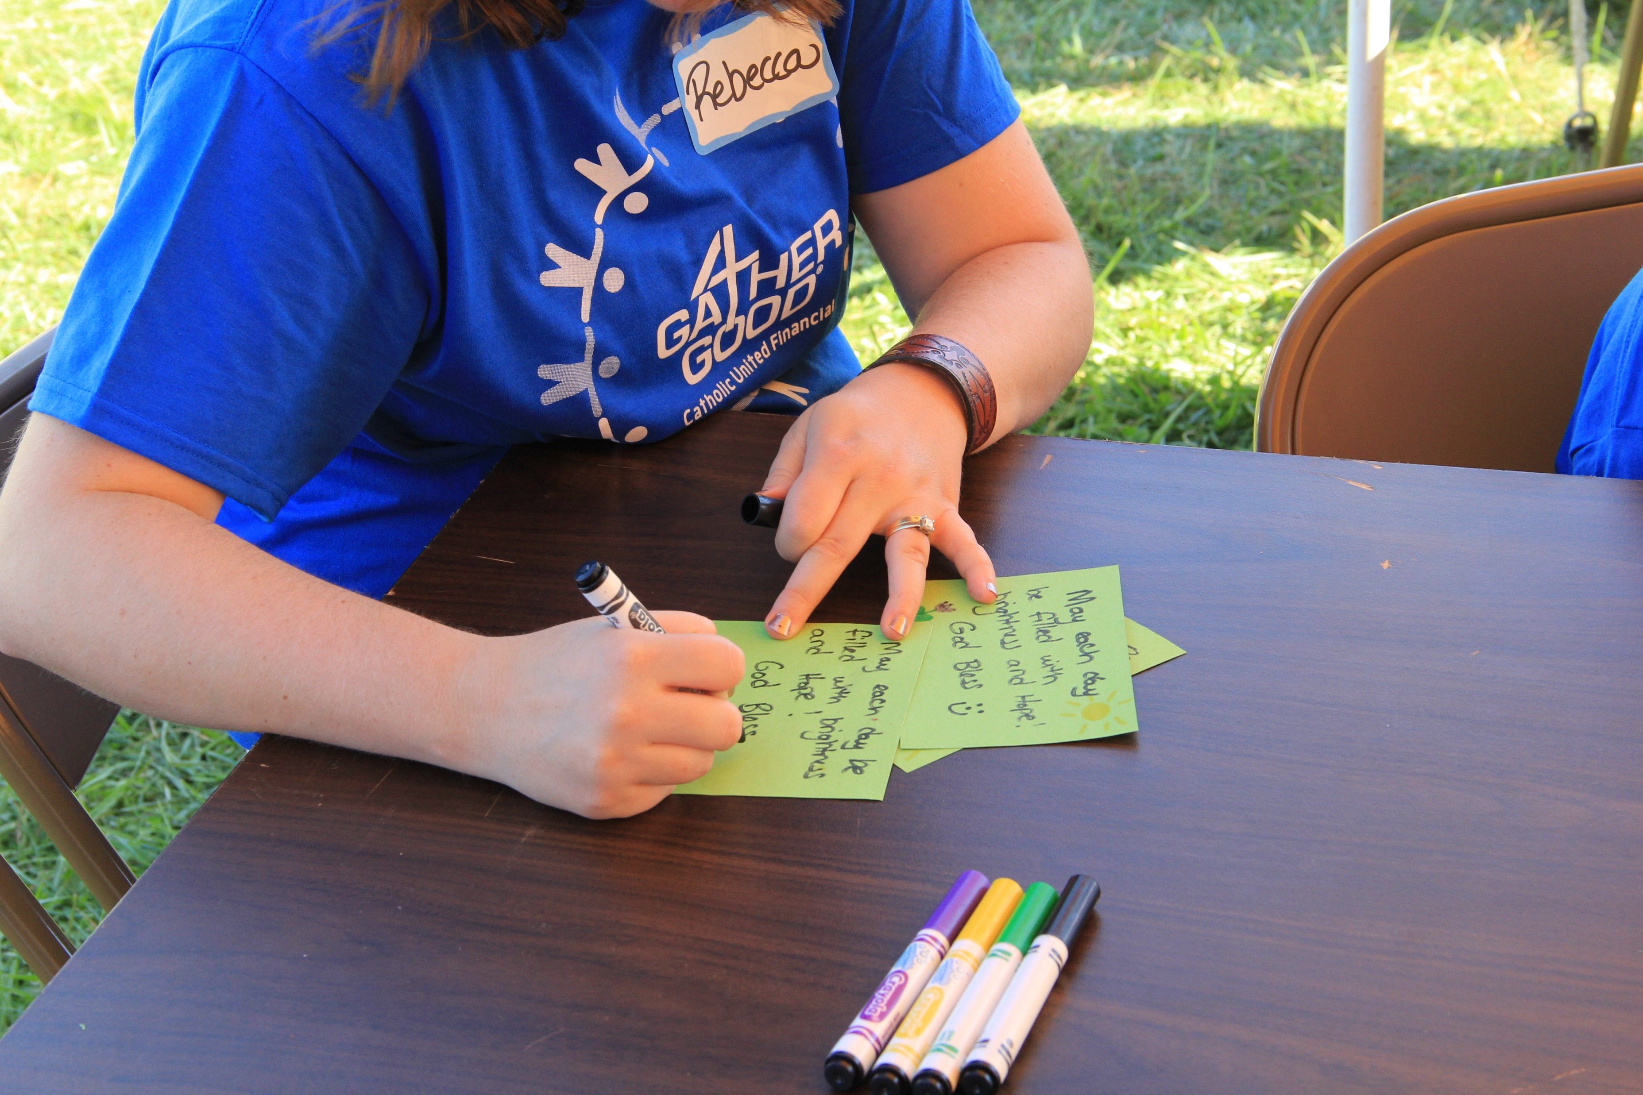
Messaging cards:
Every care kit will include a hand-written message from you!
Let’s create something!
Notes:
These messages are a reminder that no matter what the recipient of these kits may be going through, they are not forgotten.
You should each have 3-4 messaging cards sitting in front of you. Take a few minutes to fill out each of the cards with some words of hope. Feel free to use some of the sample messages provided on the next slide, or write your own.

Slide 12
Sample Messages:
Wishing you brighter skies and better tomorrows
Tough times never last, but tough people do.” - Robert H. Schuller
Our thoughts and prayers are with you.
Be strong and courageous because things will soon get better.
Every day is a new beginning.
May each day be filled with brightness and hope
Notes:
We’ll give you a few minutes to think of messages and fill out your cards. Feel free to also decorate the cards with borders, or pictures!

Slide 13
Split in to 2 groups
Group 1 starts with photos
Group 2 starts with kits
Switch when the line starts to go down/you’ve completed your kits!

