Slide 1
READY… AIM… SHOOT!
Presented by Kaye Wergedal Vestafjell Lodge #6-146 and D-6 PRO
Tips for using your smartphone (mobile device) camera to successfully showcase your lodge events.
Notes:
WELCOME TO A MINI COURSE ON USING YOUR MOBILE DEVICE, (SMARTPHONE, IPHONE, OR TABLET) TO TAKE AWESOME PHOTOS FOR YOUR LODGE!

Slide 2
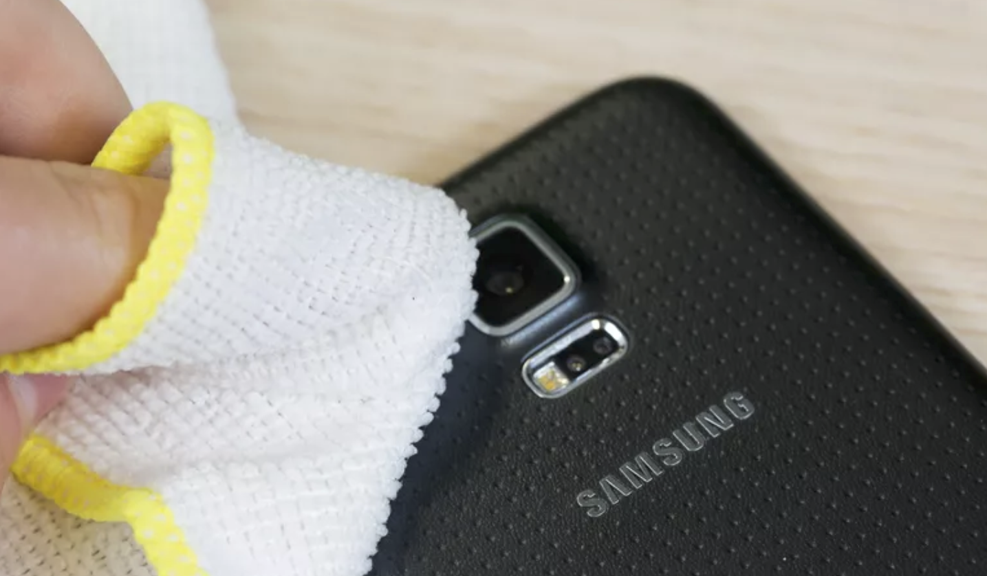
READY…
STEP 1: Clean your lens
Notes:
SOMETHING WE DON’T OFTEN EVEN THINK ABOUT. CLEANING YOUR LENS.
IMPORTANT!

Slide 3
STEP 2: Open camera settings
Tap camera icon.
Tap settings icon.
Android wheel
iphone spinner
Notes:
YOUR NOT READY, IF YOUR CAMERA IS NOT READY. SO . . . GET IT OUT . . . AND GET IT READY BEFORE YOU NEED IT.
YOUR MOBILE DEVICE HAS MANY DIFFERENT OPTIONS FOR CAMERA SETTINGS.
OPEN YOUR CAMERA SETTINGS, AND SEE WHAT YOUR CAMERA CAN DO.

Slide 4
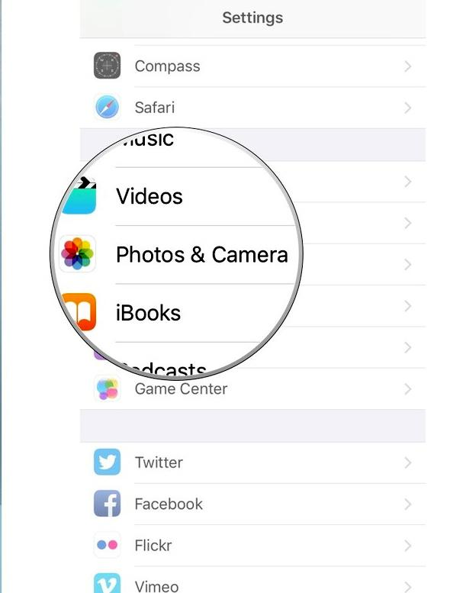
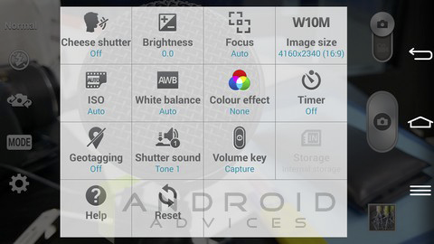
STEP 3: Adjust camera settings
Focus mode
Exposure mode
Scene mode
Picture size
Picture quality
Color effect
Store location
White balance
Flash mode
Zoom
Notes:
YOUR CAMERA (WHETHER AN ANDROID OR IOS-IPHONE) HAS SOME, IF NOT ALL, OF THESE OPTIONS!
THEY ALLOW YOU TO BE IN CONTROL OF WHAT SIZE AND QUALITY PHOTO YOUR CAMERA TAKES.
TAKE NOTE . . . WE WILL TALK MORE ABOUT THE LAST 2 . . . FLASH MODE AND ZOOM.
OTHERWISE . . . EXPERIMENT UNTIL YOU KNOW WHAT YOUR CAMERA CAN AND CANNOT DO!

Slide 5
… AIM…
Ask yourself 5 questions:
Notes:
NOW THAT YOUR CAMERA IS READY . . . LET’S GET YOU READY!
BEFORE YOU SHOOT . . . YOU HAVE TO AIM. TAKE TIME TO AIM . . . TO THINK ABOUT WHAT YOU ARE WANTING YOUR PHOTO TO LOOK LIKE. 5 FINGERS ON ONE HAND . . . 1 FOR EACH QUESTION . . . TICK THEM OFF, ONE AT A TIME:

Slide 6
Does what you see tell a STORY?
2. How is the LIGHTING?
3. Is there an interesting ANGLE or point of view?
4. Is there correct DISTANCE?
5. Is it in good FOCUS?
Notes:
“A PICTURE IS WORTH A THOUSAND WORDS”. CAN YOU SEE A STORY IN YOUR LENS?
IN SONS OF NORWAY, WE TAKE PHOTOS OF PEOPLE! OUR MEMBERS! CAN YOU SEE YOUR SUBJECTS FACES? TELL WHO IS WHO? WHAT THEY’RE DOING? LIGHTING IS EVERYTHING!
HOW ABOUT LOOKING AT THAT STORY FROM A DIFFERENT PERSPECTIVE? WOULD IT MAKE IT MORE INTERESTING?
ARE YOU CLOSE ENOUGH TO SEE WHAT’S REALLY HAPPENING? STANDING UP IN THE BACK OF THE ROOM MIGHT BE UNOBTRUSIVE, BUT IF YOU’RE IN CHARGE OF CAPTURING WHAT’S HAPPENING IN PHOTOS . . . YOU NEED TO GET UP CLOSE AND PERSONAL.
USE BOTH HANDS OR A TRIPOD OR LEAN UP AGAINST A WALL, OR ON A BOOKCASE IN ORDER TO KEEP THE CAMERA STEADY. NOTHING IS MORE DISAPPOINTING THAN A FUZZY (OUT OF FOCUS) PHOTO!

Slide 7
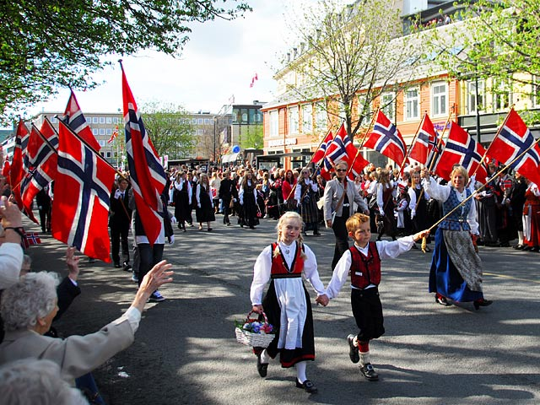
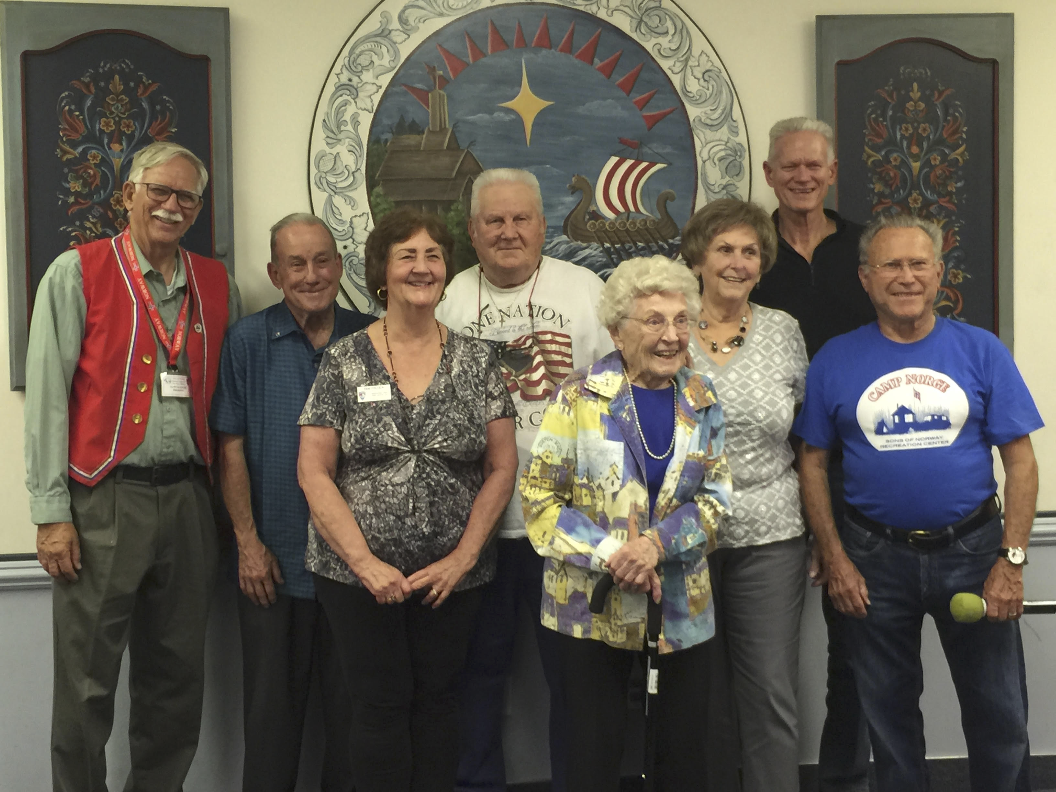
Does the picture tell a story?
Notes:
WITHOUT ADDING A CAPTION . . . WHICH PHOTO TELLS THE BETTER STORY?

Slide 8
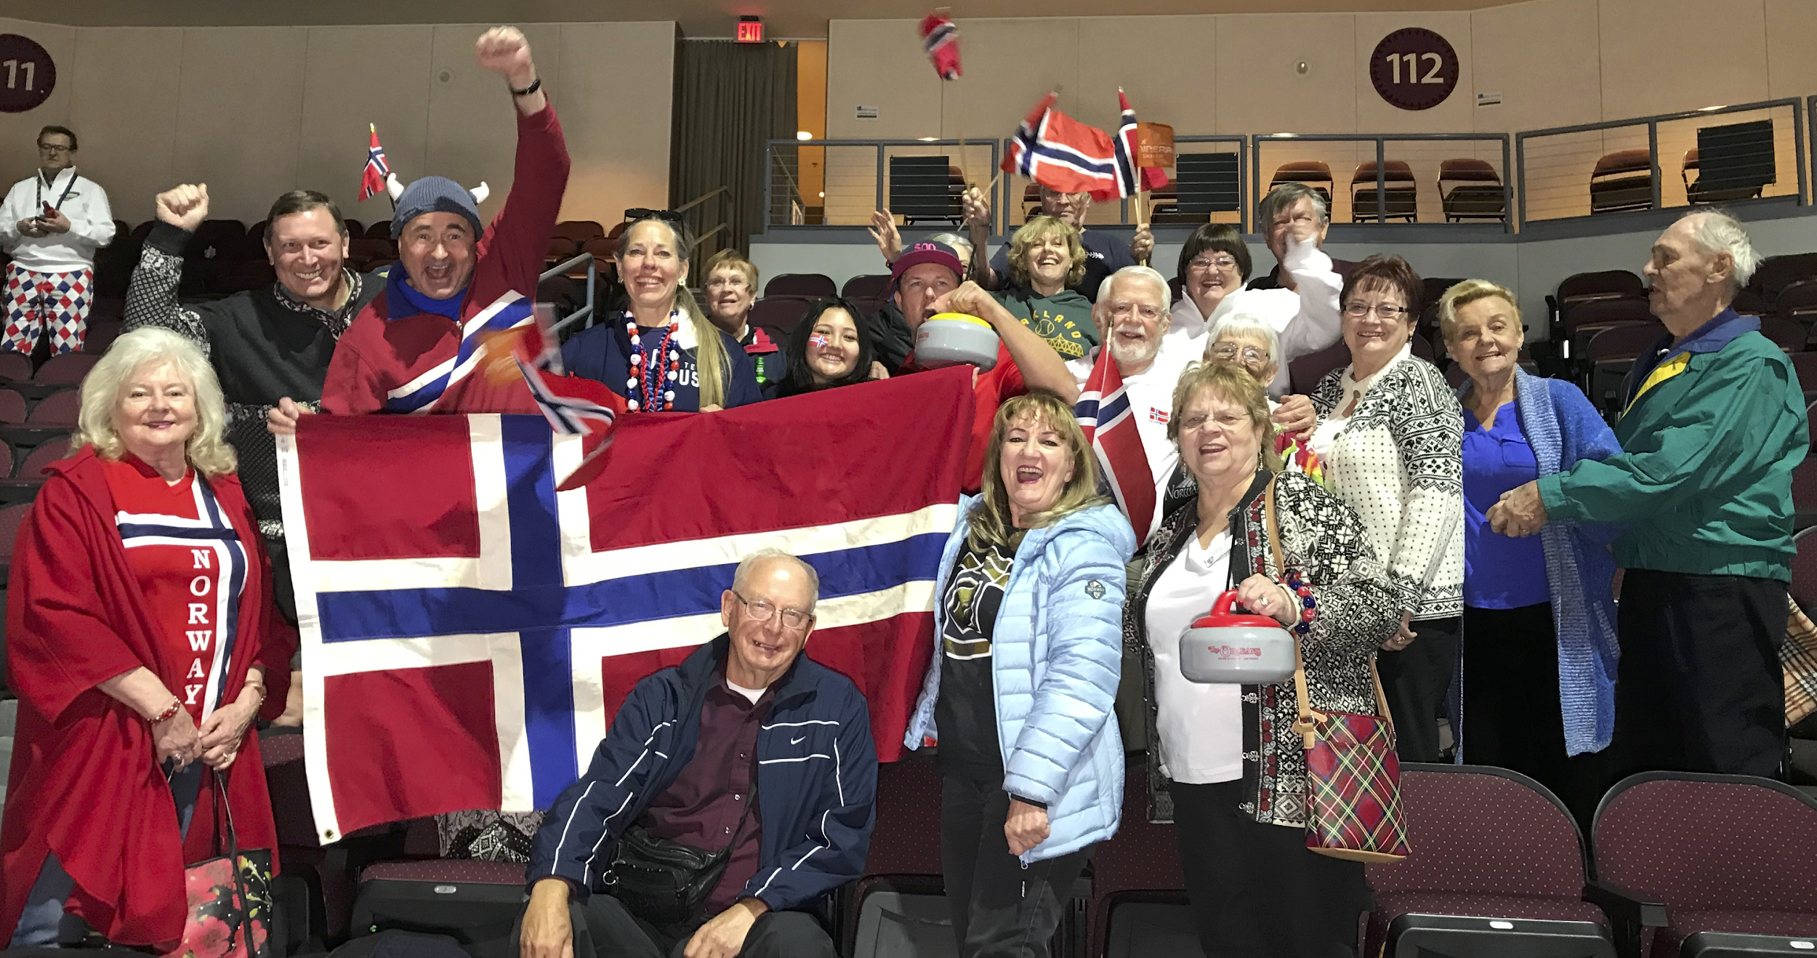
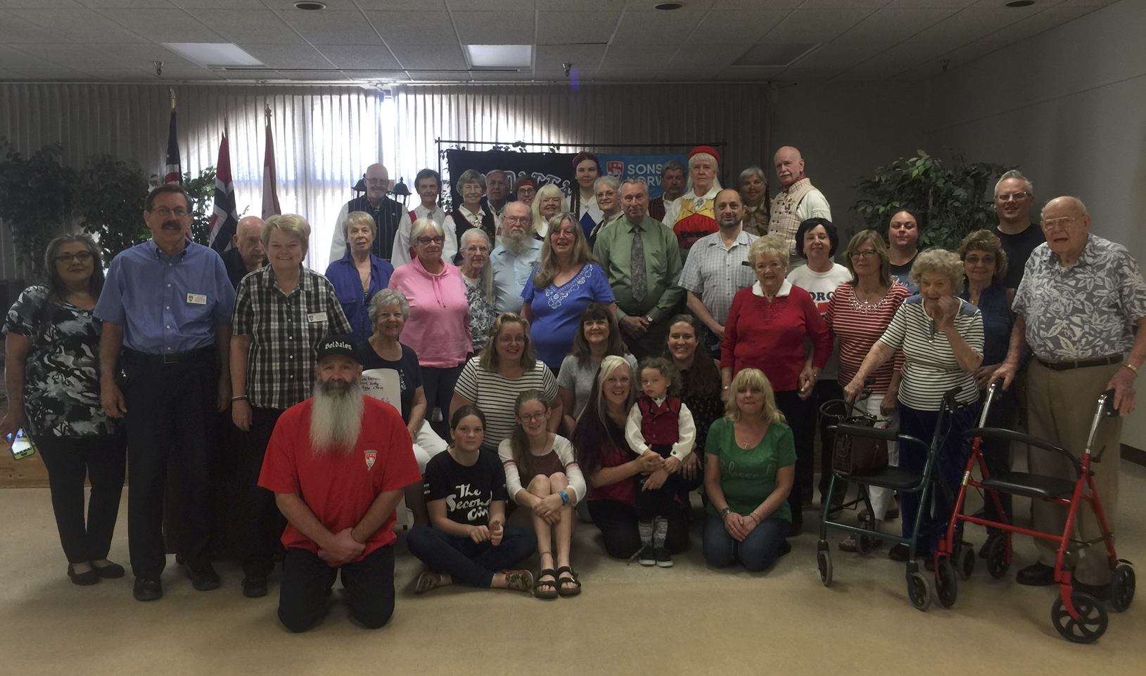
How is the lighting?
Notes:
LOOK WHERE THE LIGHT SOURCE IS COMING FROM. IS IT SHINING ON THE SUBJECTS SO YOU CAN SEE WHO THEY ARE?
OR - IS IT BEHIND THEM SO THAT THEIR FACES ARE ALL IN THE SHADOWS - AND YOU ARE LOOKING INTO THE LIGHT?
WHICH PHOTO WOULD YOU WANT TO BE IN?

Slide 9
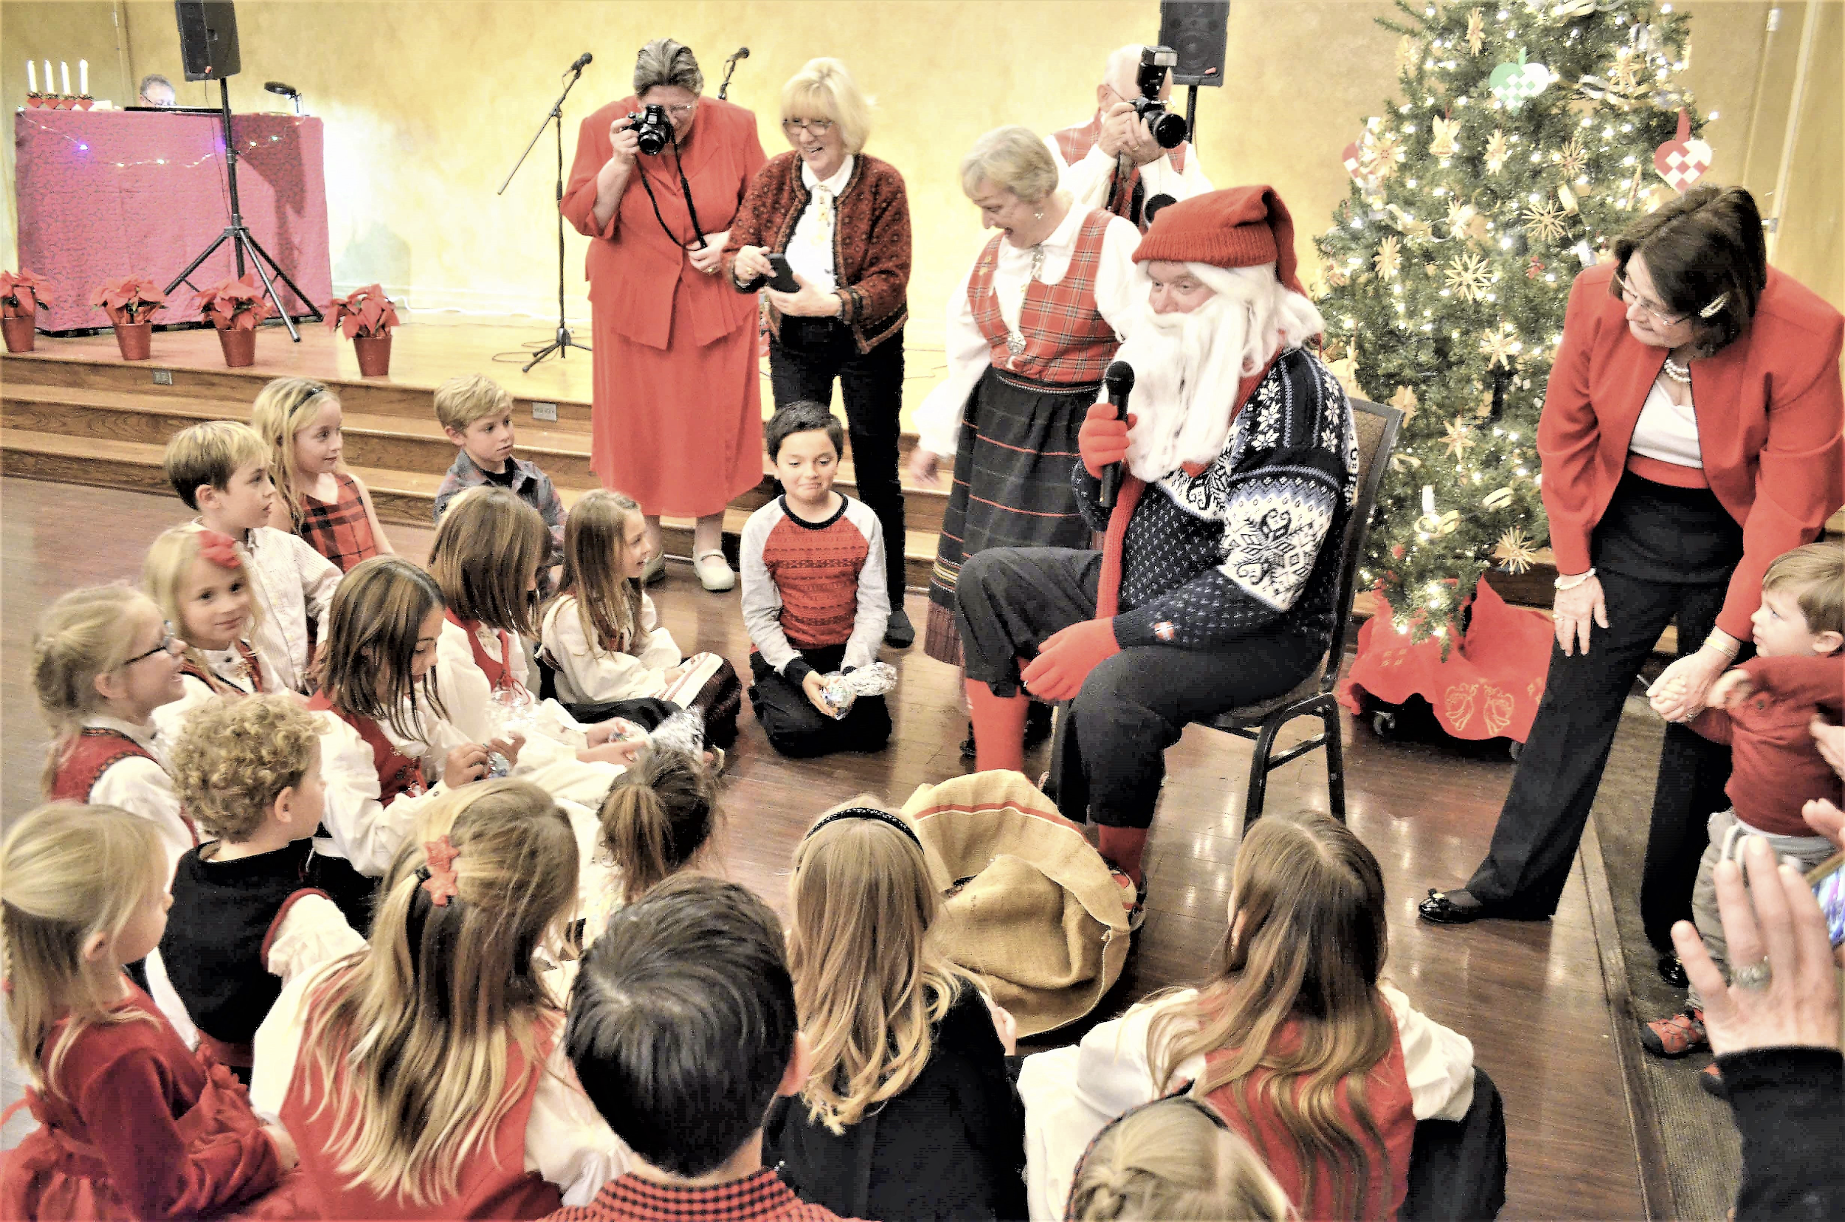
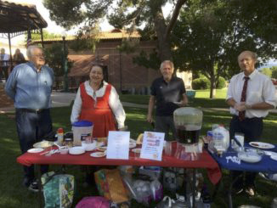
Is there an interesting angle?
Notes:
HOW ABOUT TRYING A DIFFERENT ANGLE? ABOVE? BEHIND? ALONG SIDE? WHICH IS THE MORE INTERESTING PHOTO?
STRAIGHT-ON IS USUALLY THE MOST UNINTERESTING . . . BUT THERE ARE ALWAYS EXCEPTIONS!

Slide 10
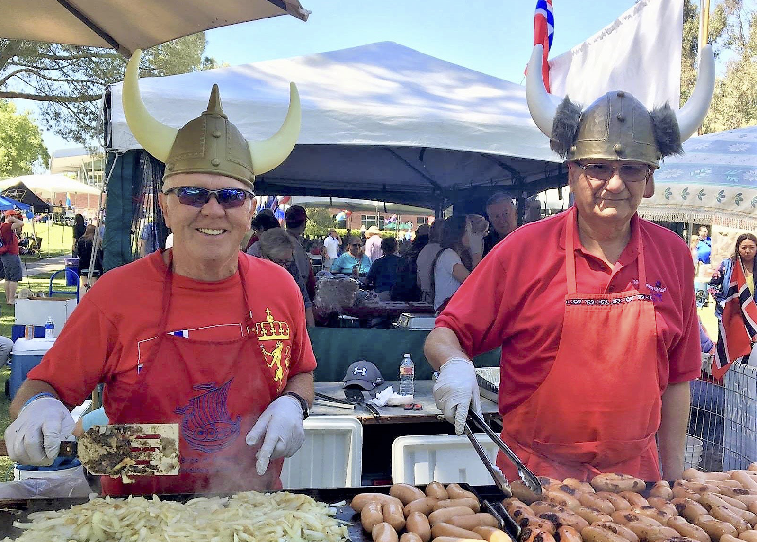
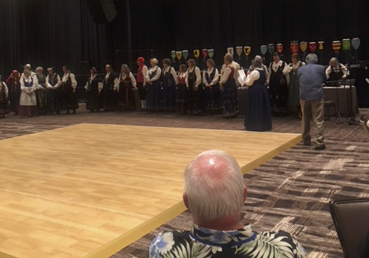
Is there correct distance?
Notes:
IT IS TRUE THAT BOTH OF THESE PHOTOS TELL A STORY. HOWEVER, WHICH STORY IS WORTH TELLING?
IN THIS CASE, IT IS THE DISTANCE THAT MAKES THE DIFFERENCE! THE ONE ON THE LEFT BRINGS YOU RIGHT INTO THE STORY, UP CLOSE AND PERSONAL. CAN’T YOU SMELL THE GRILLED POLSE AND ONIONS? DON’T YOU WANT TO ORDER ONE? THE OTHER ONE TELLS A STORY . . . BUT NOT A VERY INTERESTING ONE.

Slide 11
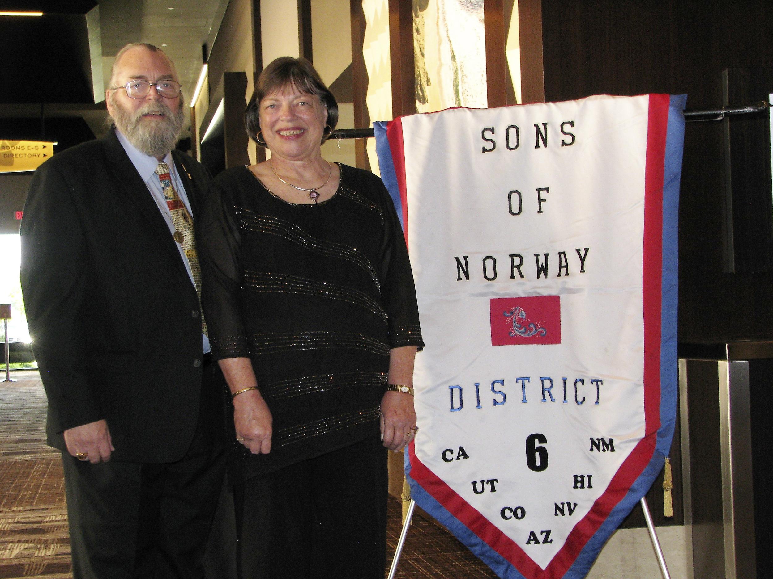
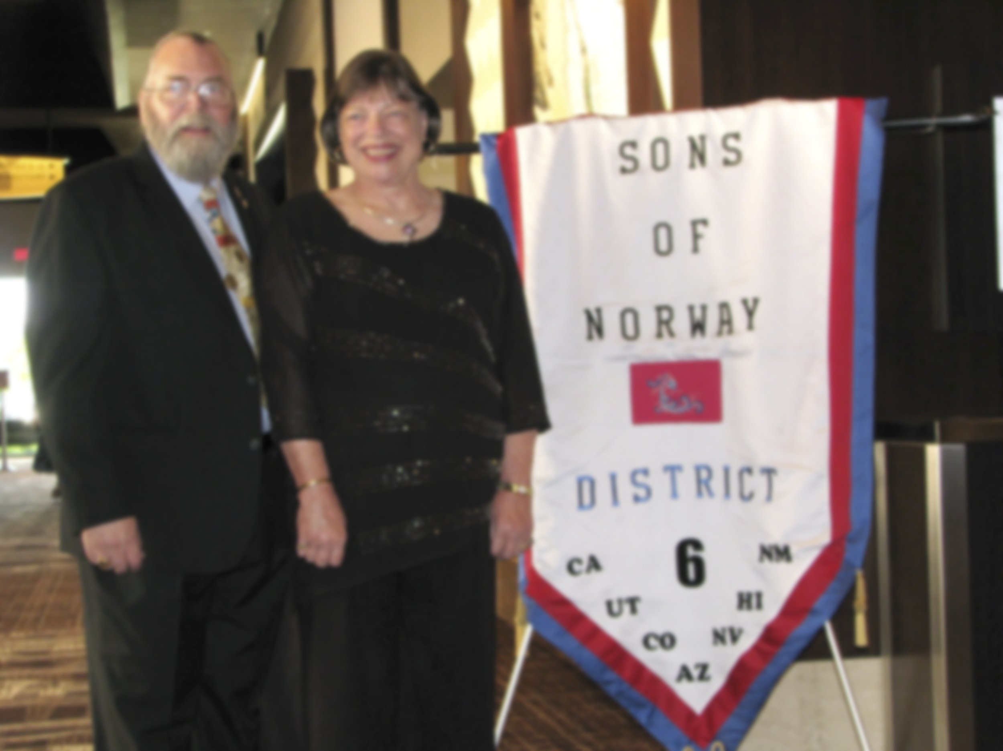
Is it in good focus?
Notes:
WHEN WE ARE CELEBRATING A SPECIAL EVENT, AND WE WANT PHOTOS OF OUR MEMBERS WHO WERE THERE . . . THAT IS A GOOD TIME TO DO A STRAIGHT-ON, POSED, PHOTO. PORTRAIT PHOTOS NEED A STEADY SET OF HANDS, OR SOMETHING TO REST ON IN ORDER TO KEEP THE CAMERA STILL AND IN FOCUS. OTHERWISE, YOU OFTEN END UP WITH A PHOTO THAT LOOKS LIKE THE “THUMBS DOWN” ONE.

Slide 12
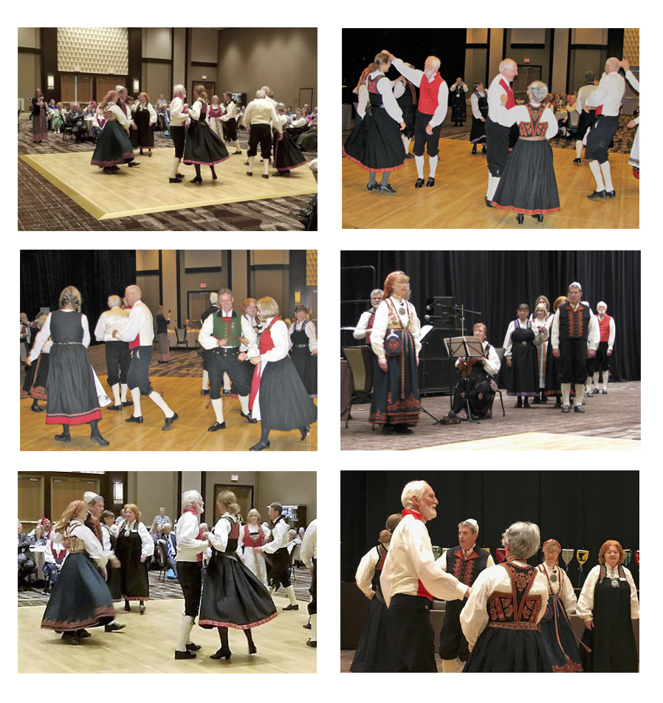
…SHOOT...
Take multiple shots.
Move around to change light, angle and distance.
Turn on flash ONLY when necessary.
Zoom with your feet NOT with your camera.
Notes:
NOW THAT YOU’VE GONE THROUGH THE 5 AIM QUESTIONS . . . YOU ARE READY TO SHOOT!
TAKING MULTIPLE SHOTS (SOME CALL THEM BOOST SHOTS - WHERE YOU JUST PRESS DOWN ON THE “TAKE” BUTTON” AND “LET ‘ER RIP” WHILE YOU MOVE AROUND, GIVES YOU A VARIETY OF SHOTS TO CHOOSE FROM.
REMEMBER “FLASH” AND “ZOOM” FROM THE SETTINGS OPTIONS? WELL HERE IS WHERE YOU WANT TO USE THEM EFFECTIVELY. ONLY USE YOUR FLASH WHEN:
YOU ARE FAR ENOUGH AWAY FROM THE SUBJECTS THAT IT WILL NOT CAUSE A GLARE ON THEM,
THE AVAILABLE LIGHTING IS TOO POOR TO LIGHT YOUR SUBJECTS
YOU CANNOT MOVE YOUR SUBJECTS TO WHERE THERE IS BETTER LIGHTING.
NEVER USE YOUR ZOOM FEATURE. USE YOUR FEET TO GET THE BEST DISTANCE FOR THE CLEAREST PHOTO.

Slide 13
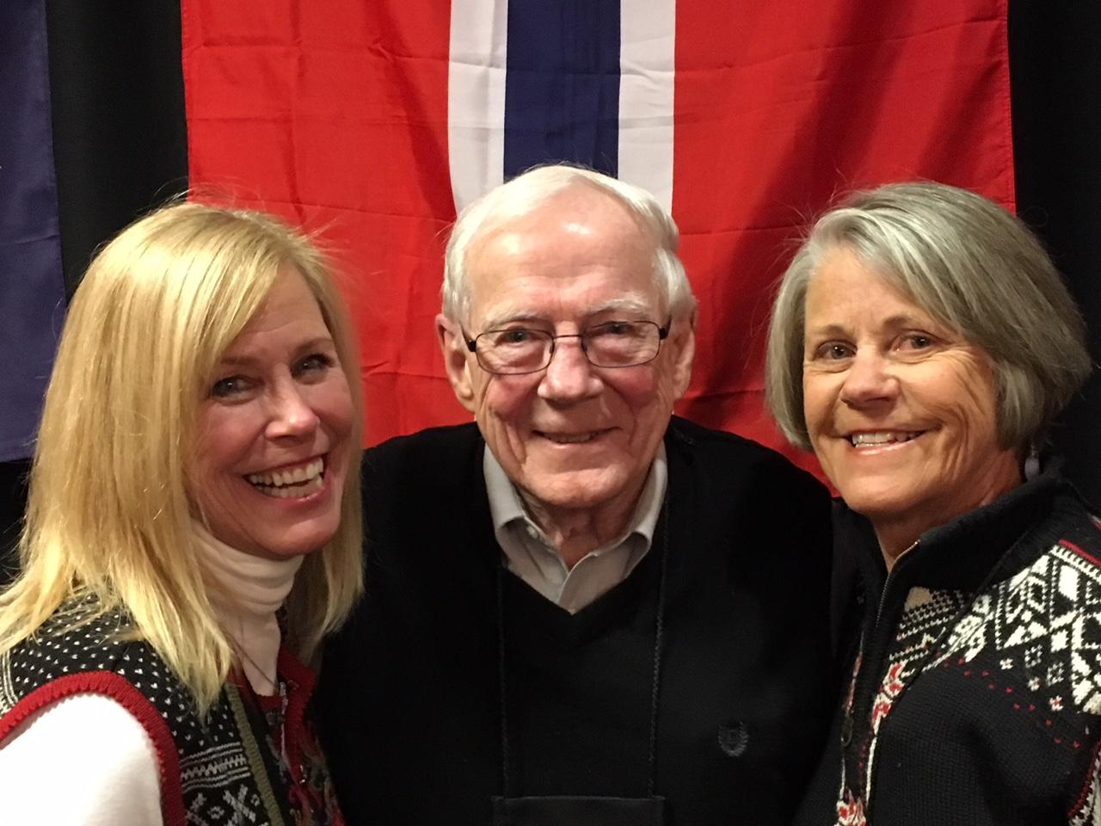
Review all your photos.
Select the image that best illustrates “S,L,A,D,F.
STORY LIGHTING ANGLE DISTANCE FOCUS
International President, Jon Tehven, with Vestafjell Lodge #6-146 members at 2018 Ski For Light event.
Notes:
THEN . . . THE FUN BEGINS. PICK YOUR BEST SHOTS. FOR EVERY SHOT ASK YOURSELF THOSE SAME 5 QUESTIONS ALL OVER AGAIN. STORY? LIGHTING? ANGLE? DISTANCE? FOCUS?
IF YOU’RE HAPPY WITH RESPECT TO ALL OF THOSE - THEN THIS IS A KEEPER! LIKE THE ONE ABOVE!
IT MAKES YOU WANT TO BE WHERE THESE FOLKS ARE - THEY LOOK LIKE THEY’RE HAVING A GOOD TIME, ENJOYING EACH OTHER’S COMPANY AND DOING SOMETHING TO DO WITH NORWAY.
THAT’S THE GROUP I WANT TO JOIN. HOW ABOUT YOU?

Slide 14
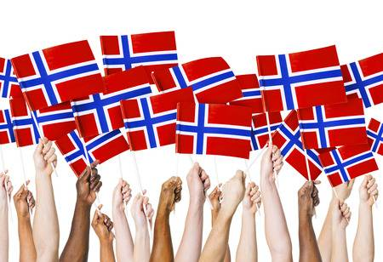
Tusen Takk
Credits to: Dave Endo for District Six photos and District Six Lodges for photos
Courtesy of Dayna Studios
Notes:
NOW . . . TAKE UP YOUR DEVICES . . . AND, GET READY . . . AIM . . . AND SHOOT
SOME AWESOME PHOTOS!
GOOD LUCK AND TUSEN TAKK FOR YOUR ATTENTION!

